Slide 1
Cluster Evaluation

Slide 2
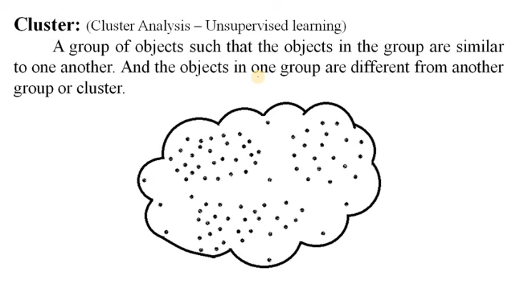

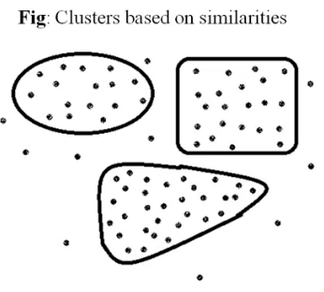

Slide 3
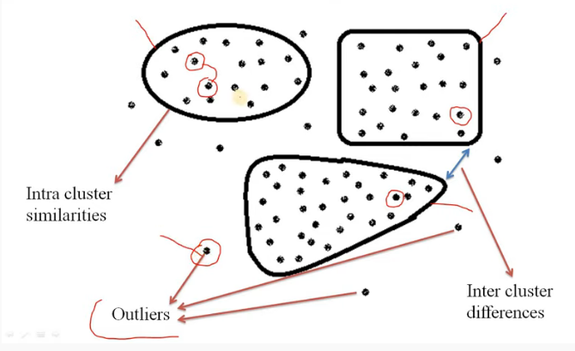

Slide 4
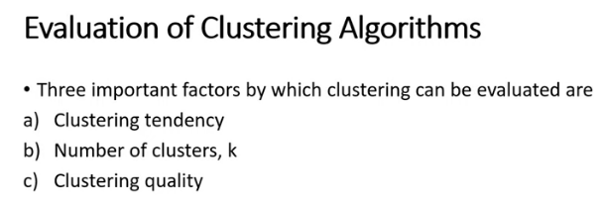

Slide 5
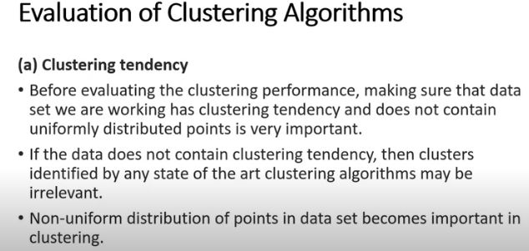

Slide 6
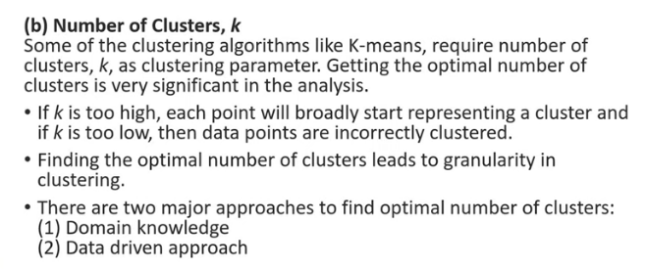

Slide 8
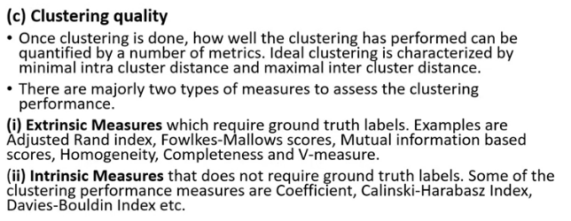

Slide 9
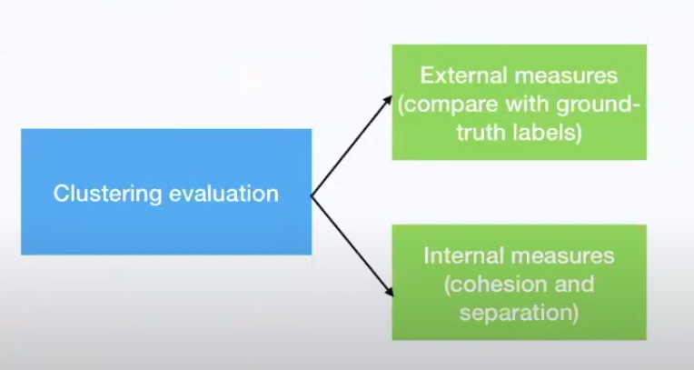

Slide 10
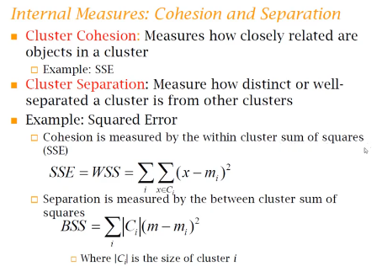

Slide 11
Validity Index
1.Validity based o Intra and Inter Cluster
Distance Ratio
2.Gain
3.Silhoutte Co-efficeient

Slide 12
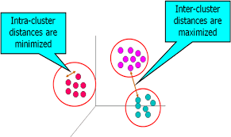
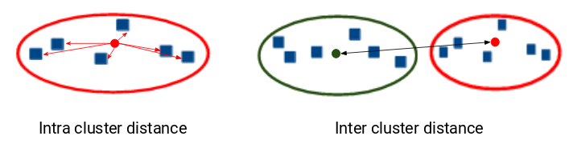
Validity based on Intra and Inter Cluster Distance

Slide 13
Validity Index
Validity= Intra Cluster Distance /Inter Cluster
Distance
Intra=1/n Sum(Sum(dist(x,ci))
Inter=For every cluster i and j find Min(dist(ci,cj))
n=number of data points
k=no of cluster
ci-center of ith Cluster
x= data point

Slide 14
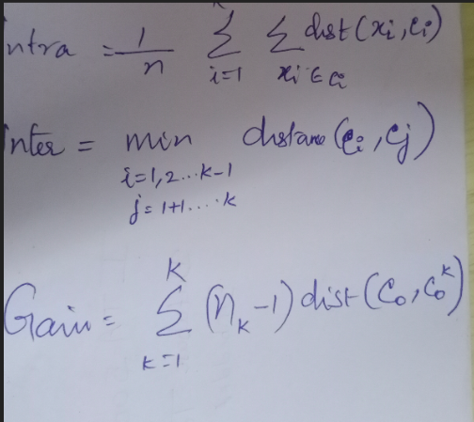

Slide 15
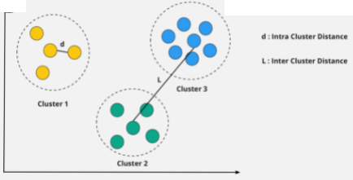

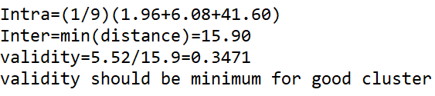

Slide 16
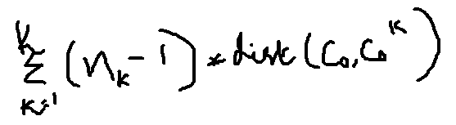

Gain

Slide 17

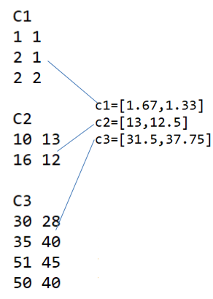
C0=[22.78,20]
Gain=(3-1) dist(C0,C01)+(2-1)*dist(C0,C02)+(4-1)dist(C0,C03)
= 146.08

Slide 18
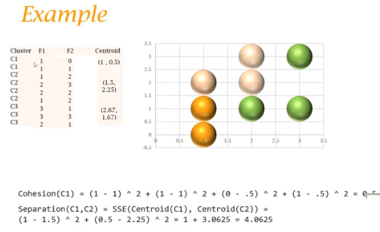

Slide 19
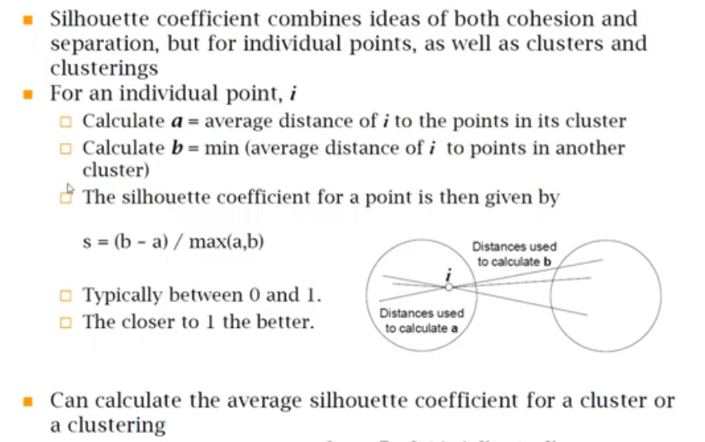

Slide 20
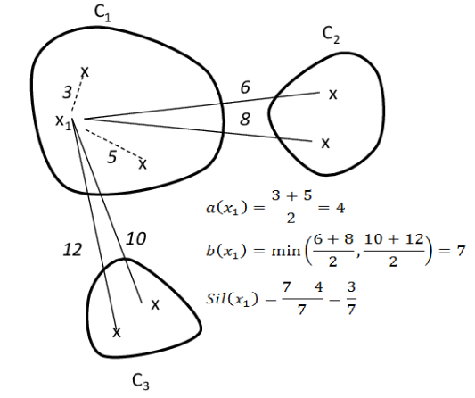
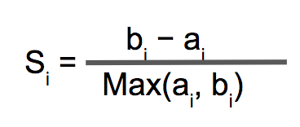

Slide 21
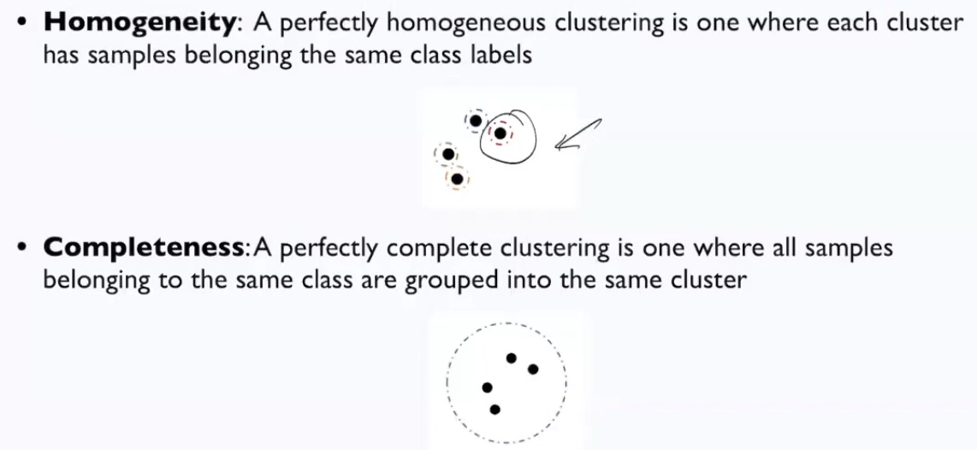

Slide 22
